Slide 1
Git social
git / github / markdown / pull requests / branching & Git-Credential-Manager-Core

Slide 2
Two scientists walk into a avoid bars
Goals for this session
Creating GitHub web page & GitHub profile
Fork - a "social" setting to take credit for others work
Authentication - Git-Credential-Manager-Core
git rebase - demo … If we have time
upstream vs origin / remote source URLS...
gitkraken
Conclusions...

Slide 3
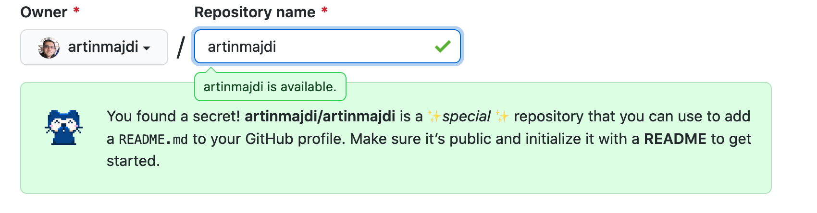
Let’s create our first (GitHub) webpage
Step 1: Create a Repository
Make sure you add a README file
Set to public
Bonus point: if you name your new repository, similar to your username, you can use it as your github.io webpage and your github profile page
goto: https://github.com/ua-data7/default_page

Slide 4
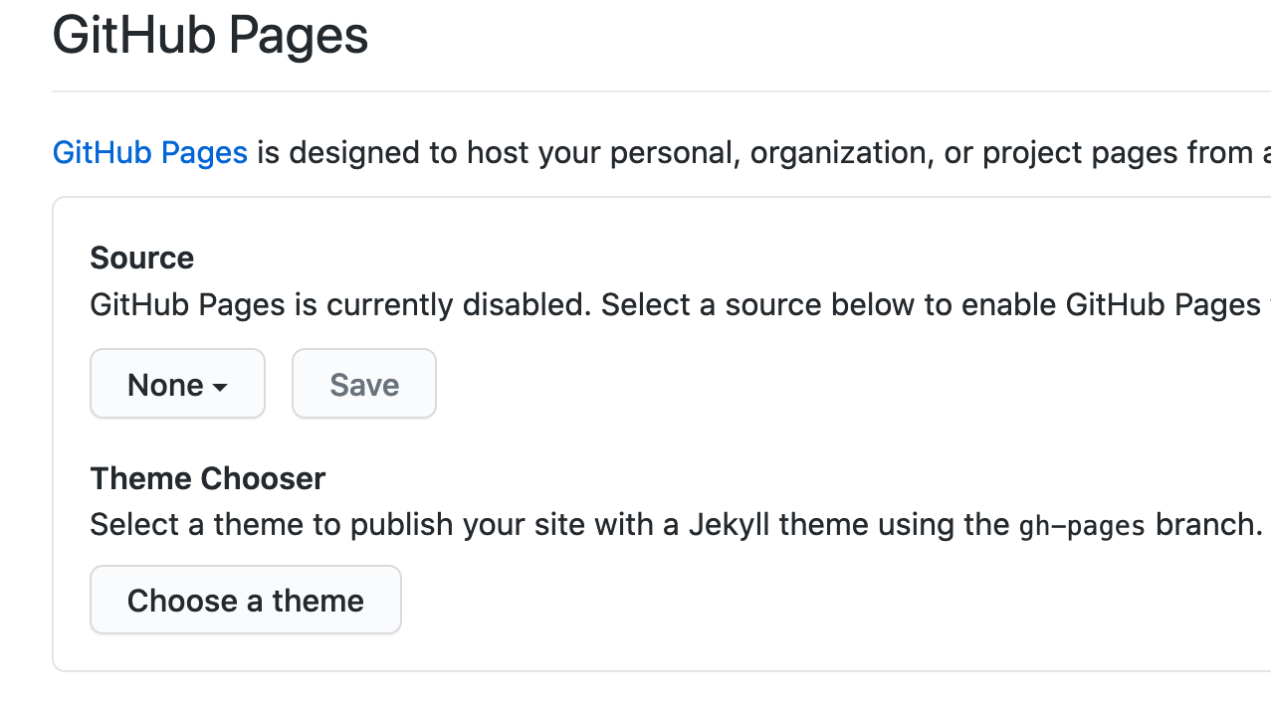
Let’s create our first (GitHub) webpage
Step 2: Go to your new repo => Go to settings => Scroll down to GitHub Pages
Step 3: Click on Choose a theme => select your theme
Scroll to the bottom of the page and commit index.md
Step 4: Now let’s check your github profile: https://<github-username>.github.io/<repo-name>

Slide 5
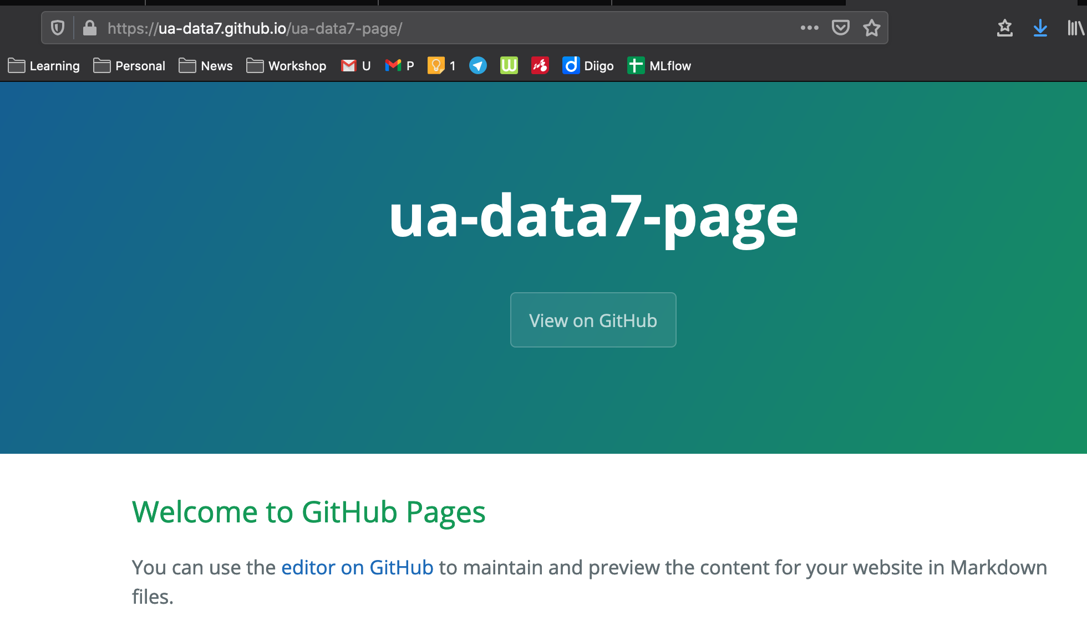

Slide 6
Let’s update our GitHub profile
Option 1: Go to settings => Branches => change main branch to gh-pages
=> rename or duplicate index.md to README.md
Option 2: The github way!
Step 1: Clone the repo to your local machine
Step 2: Git checkout to gh-pages branch
Step 3: Rename index.md to README.md
Step 4: Merge this branch to your main branch
Now let’s check your github profile: https://github.com/<github-username>

Slide 7
Pull request, lettuce fork
Time for a pairs programming exercise! Our goal here is learn how to use github's pull request feature. (Note: bitbucket / gitlab have similar features)
Let's pretend Allison is the repo owner of collab, Steve is a contributor and wants to add a line to the collab README.md file.
goto: https://github.com/ua-data7/collab
Notes:
This is a good skill if you want to contribute to someone else's repo you don't actually know (maybe you do) and butt into their life with your solutions (wanted or not).
To find a partner won't matter much as we'll attempt to wing this part and leverage github's comment system to orchestrate chaos.

Slide 8

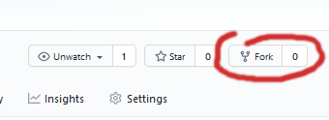
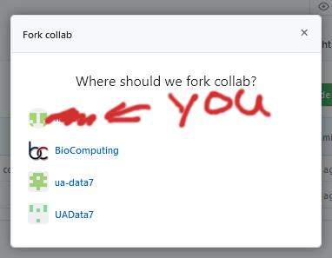
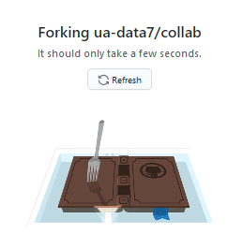
Create a fork of collab
https://github.com/ua-data7/collab

Slide 9
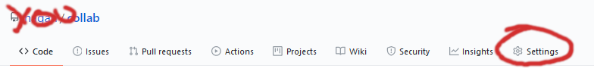
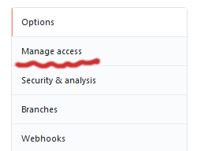
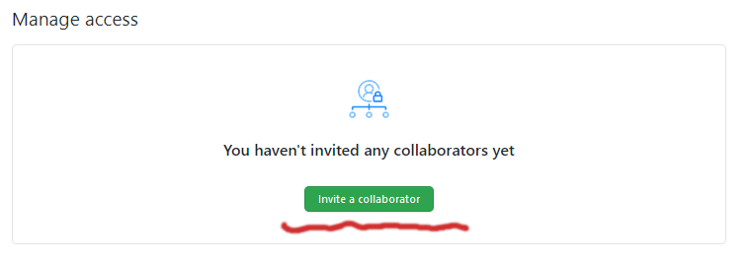
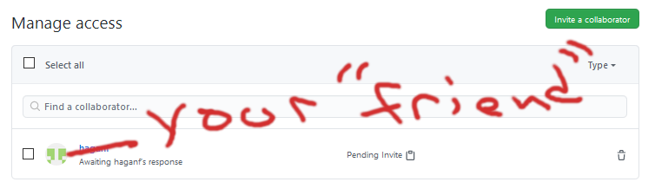
You could invite all your friends one acquaintance...
If you wanted to give access to "Steve" you could invite him. Goto settings -> Manage Access -> Invite collaborator

Slide 10
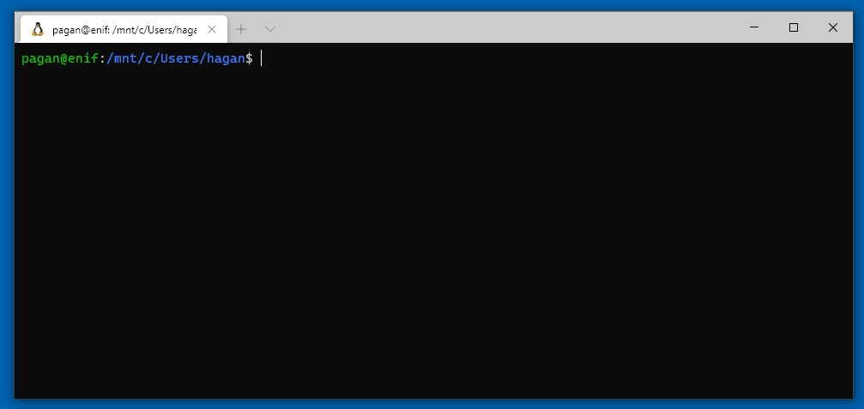
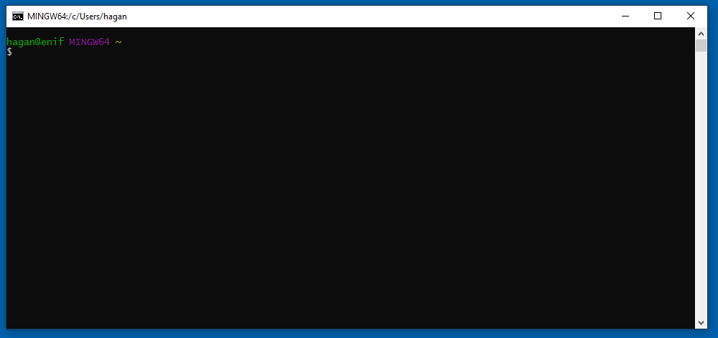
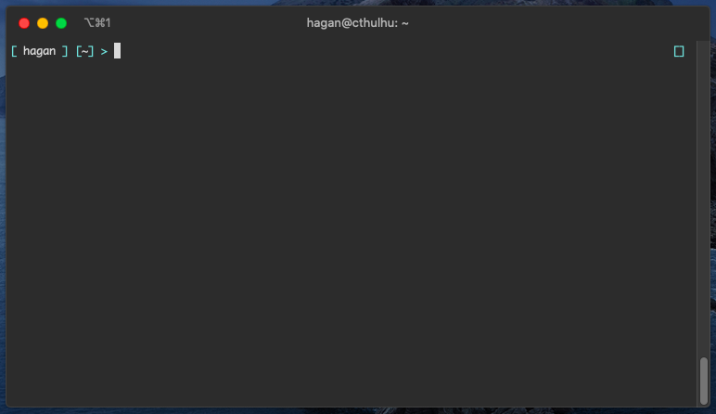
git clone… Is anyone having déjà vu yet?
Open a terminal!
Did we setup our ssh keys yet?

Slide 11
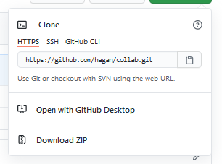
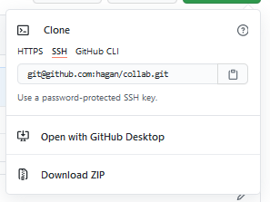
To https or ssh git repository?
If you opt to use a git token OR Git-Credential-Manager-Core, use https. It's easier, possibly safer.
However, if you already have ssh working with git, stick with that.

Slide 12

Further reading on Git Credential Manager
https://github.com/microsoft/Git-Credential-Manager-Core
Use https as your urls if you use the Credential Manager. And if you need to change you can you can always run the command below to update the url.
git remote set-url origin https://github.com/<your username here>/collab.git

Slide 13
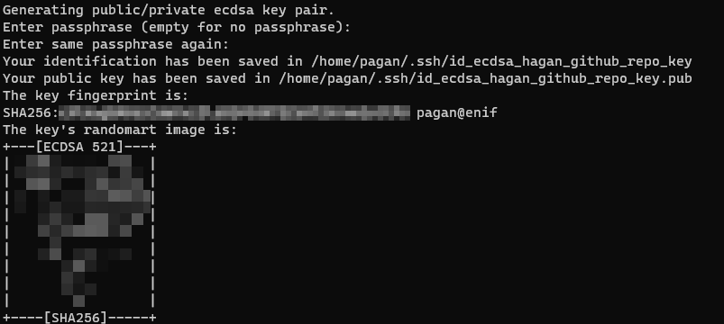
Possibly redundant.. ssh setup
ssh-keygen -f ~/.ssh/id_<does not matter name>_key -t ecdsa -b 521
Notes:
I create one off keys for this...

Slide 14
Add key to our account...
cat ~/.ssh/id_ecdsa_hagan_github_repo_key.pub
Select and copy this string ( windows/linux: ctrl-c / mac: command-c)
ecdsa-sha2-nistp521 AAAA**********************************************************************************************************************************************************************************************************************************== pagan@enif

Slide 15
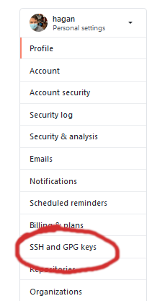
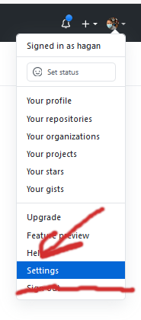

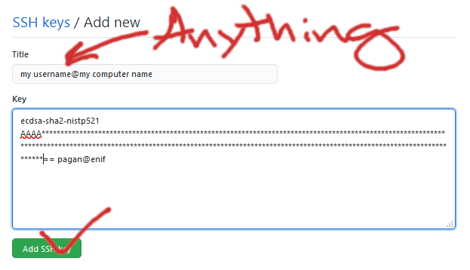
Load key into your account...
Goto: https://github.com/settings/profile

Slide 16
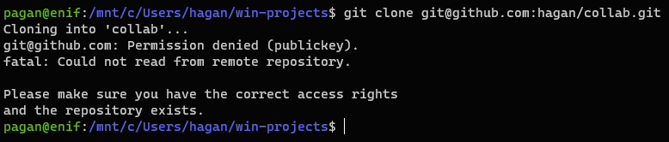

Now lets git clone...
git clone git@github.com:<your username>/collab.git
Two options: 1) git "config" command 2) Edit ~/.git/config

Slide 17
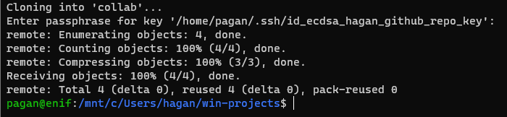
Method 1: Clone with git config option...
git clone <REPO URL> --config core.sshCommand="ssh -i <your private key>"

Slide 18
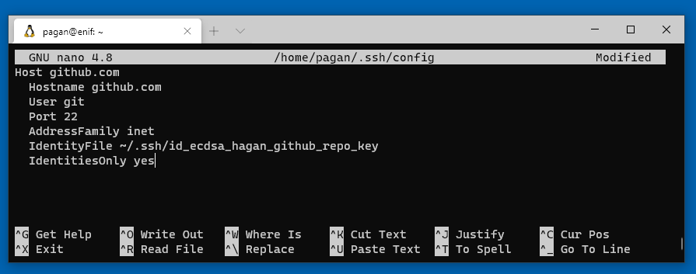
Method 2: Just override ssh/config for github.com
nano ~/.ssh/config
Host github.com Hostname github.com User git Port 22 AddressFamily inet IdentityFile ~/.ssh/<your private key here> IdentitiesOnly yes
Note: Pick one

Slide 19
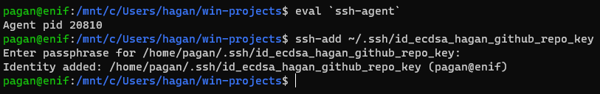
Clone with a persistent ssh agent!
I use this a lot… If you know this and have it working, do not touch!
eval `ssh-agent` ssh-add ~/.ssh/<your private key>
Better still, have this launch with your shell/command terminal found here: http://rabexc.org/posts/pitfalls-of-ssh-agents

Slide 20
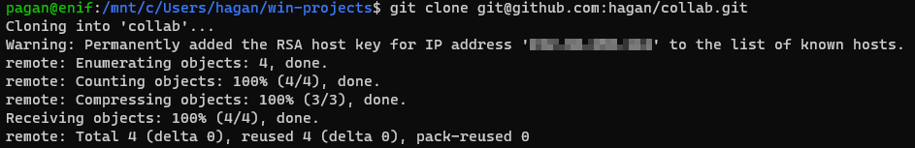
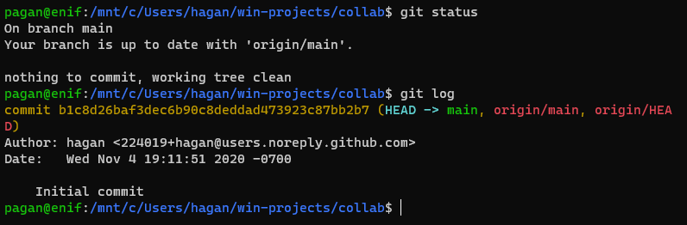
Git clone "our" version locally (using ssh url)
git clone git@github.com:<your username>/collab.git; cd collab
git status
git log

Slide 21
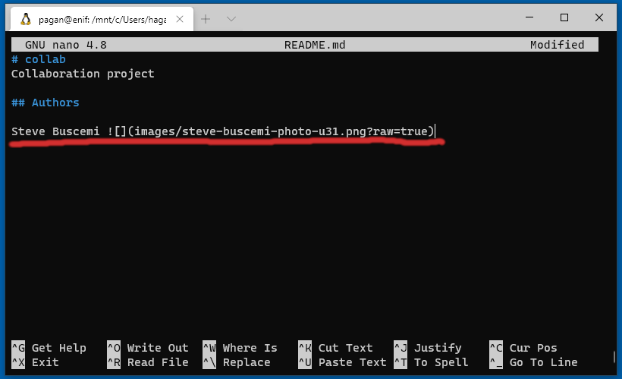
Edit the README file..
nano README.md

Slide 22
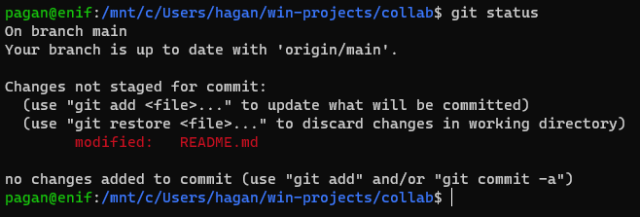
What changed?
git status

Slide 23
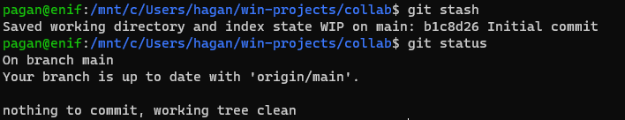
Wait.. lets stash this work for a second….
Temporarily save your work by:
git stash
git status

Slide 24

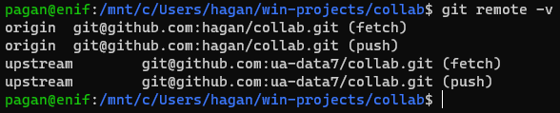
Remote URLs (again, using ssh keys)….
git remote -v
git remote add upstream git@github.com:ua-data7/collab.git
You can go into more depth here: https://git-scm.com/book/en/v2/Git-Basics-Working-with-Remotes

Slide 25
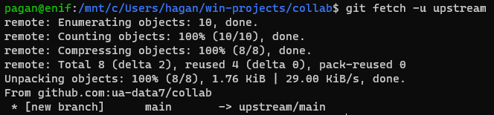

Challenges you will face...
After a few minutes and merges later, your local copy is now outdated.
git fetch -u upstream

Slide 26
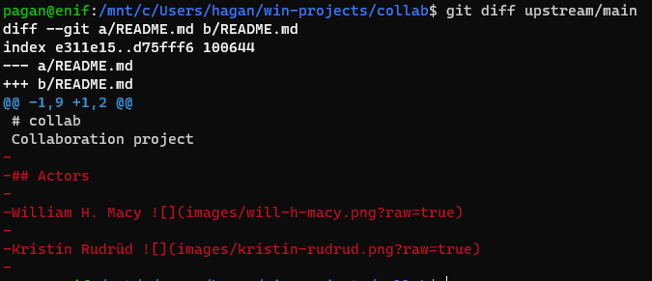
Hmm.. did things change on us?
git diff upstream/main

Slide 27
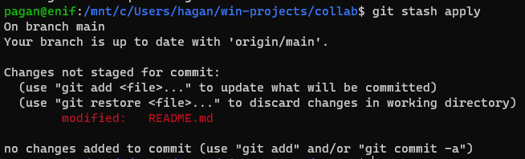
Let's make some mistakes
git stash apply
git commit -am "some interesting tidbits about Steve"

Slide 28
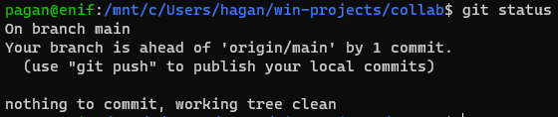
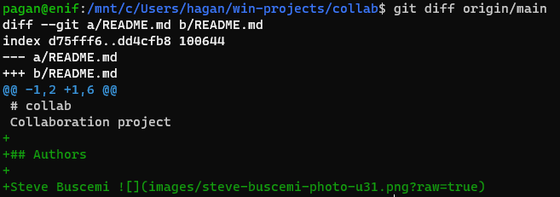
Now your local copy is one commit ahead of origin
git status
git diff origin/main

Slide 29
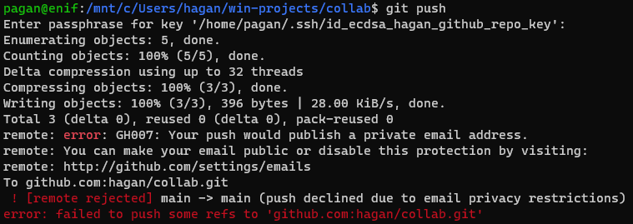

Continue with our mistake, lets update our repo
git push
Notes:
i have keep my email protected set...

Slide 30
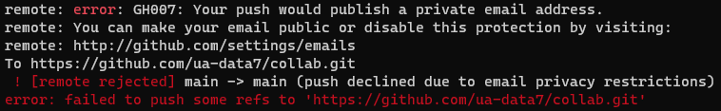

Setting "keep my email address private…"
Side quest: If you wish to hide your email address before working with others! Or perhaps you get this:
You likely have "keep my email private". Goto: https://github.com/settings/emails
You don't need to enable this, it's off by default but be aware of this.

Slide 31
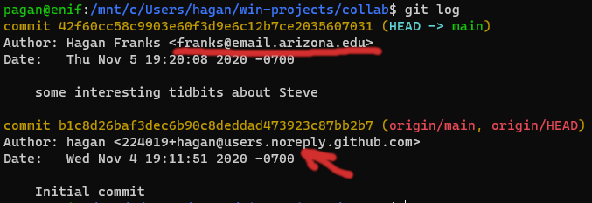

And what was wrong...
git log
Fix our last commit!
git commit --amend --author="hagan <224019+hagan@users.noreply.github.com>"

Slide 32

Update your local git repo's email attribution...
Currently my global & local email is:
Now update to the private email for git (for your local repo):
Now our user.email attribution is set to that private email address.

Slide 33
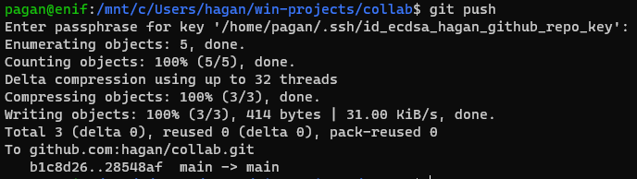
git push try 2?
git push

Slide 34
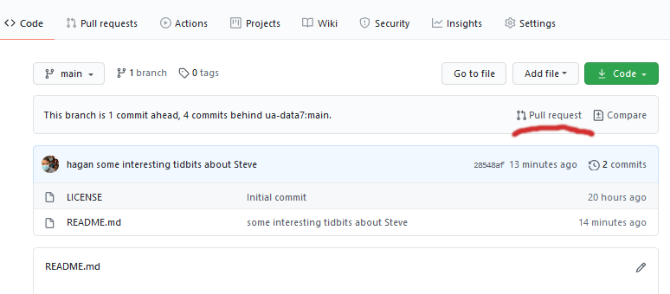
Create a PR
goto: https://github.com/<your username>/collab

Slide 35
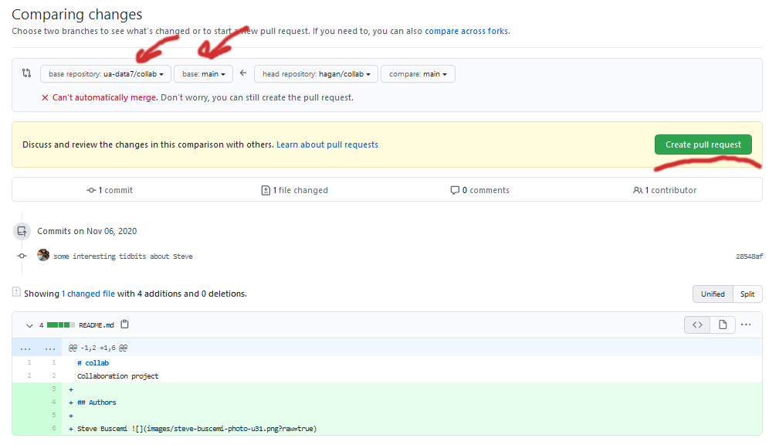
Create PR Cont...
Make sure it's pointing to the correct repo!

Slide 36
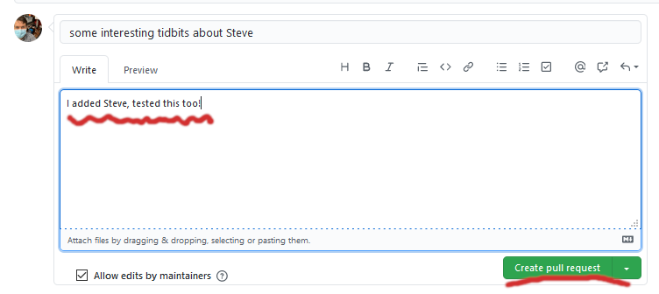
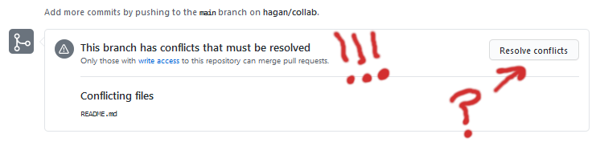
Create PR Cont...
Add some relevant comments for the maintainers "upstream"

Slide 37
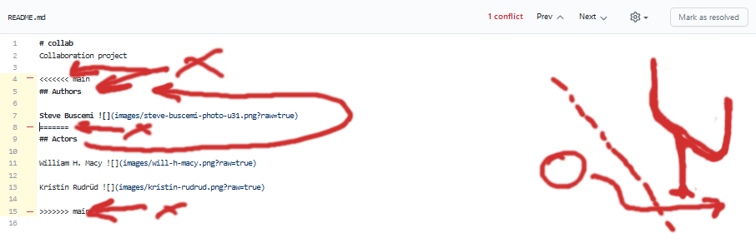
Create PR cont...
remove conflicts

Slide 38
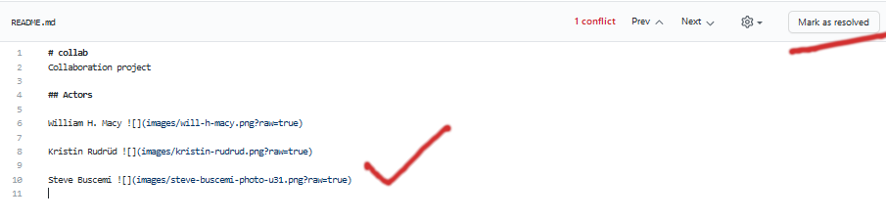
Create PR cont...
You can resolve conflicts right in github.com! Or via command….

Slide 39
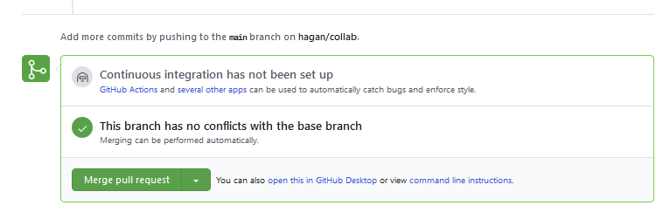
After the PR is in…
This is where the repo owner "Allison" would approve/reject the PR request.

Slide 40
Create PR cont...
Alternatively you can use the command line to resolve these conflicts too.
Update your upstream (git fetch -u upstream)
rebase your "main" against upstream (git rebase -i upstream/main)
Then force push changes to your repo (git push -f origin/main)
FYI: Step 3 keeps me up at night so probably best you use github's conflict resolver.

Slide 41
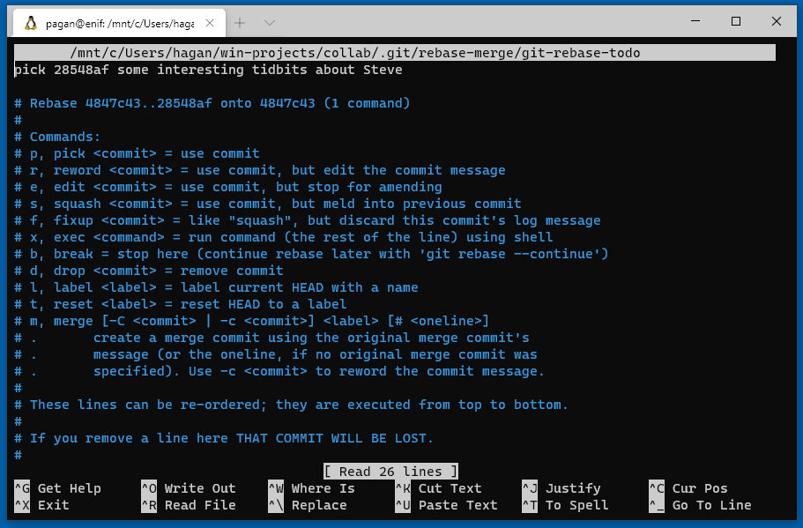
Create PR cont… (Resolve conflicts via command)
git rebase -i upstream/main

Slide 42
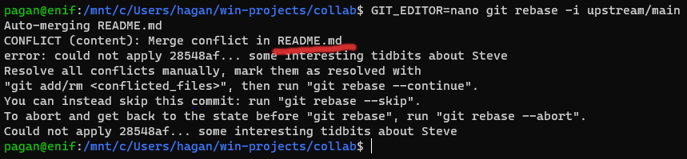
Create PR cont… (Resolve conflicts via command)
If you need to abort this, you can always: git rebase --abort
We'll edit that README.md and take careful notice the lines: <<<<<< HEAD ====== >>>>>>

Slide 43
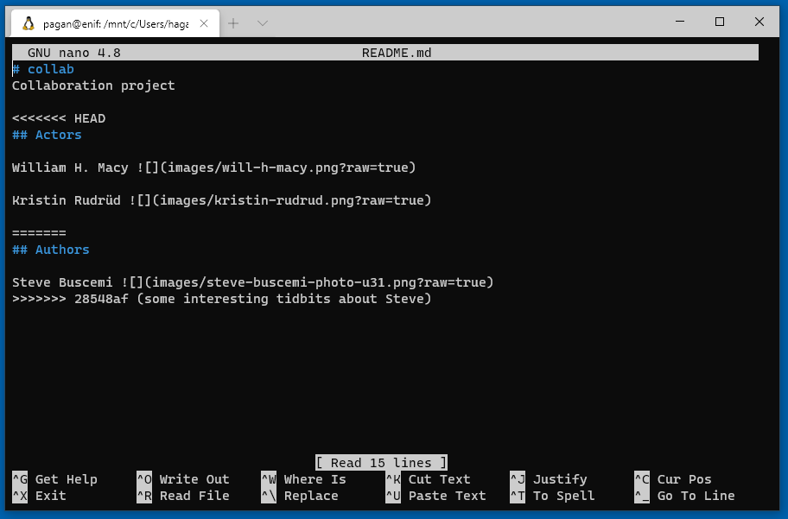
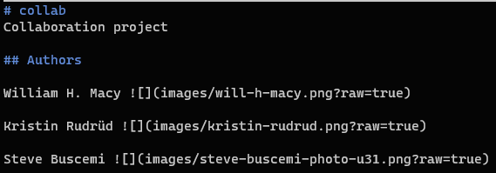
Create PR cont… (Resolve conflicts via command)
Fix conflicting files: nano README.md

Slide 44
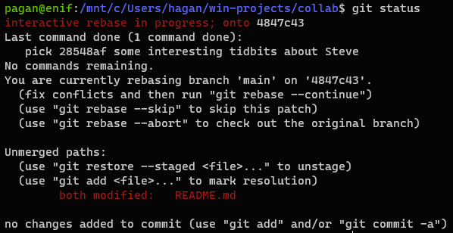

Create PR cont… (Resolve conflicts via command)
Show what's next: git status
Add our change: git add README.md

Slide 45



Create PR cont… (Resolve conflicts via command)
The rebase will open up here, close nano and then update your ORIGIN
git push

Slide 46

Using git push --force options, (Is dangerous)
This is command can cost you work so beware that it replaces your remote "origin" with your local copy.
git push -u origin -f

Slide 47


Check if our PR can merge now...
Then comment/merge the request and your all set.
Then update your local upstream with: git fetch -u upstream

Slide 48

Going further...
gitkraken?
https://www.gitkraken.com/
Branching?
https://bocoup.com/blog/git-workflow-walkthrough-feature-branches https://stackabuse.com/git-merge-branch-into-master/
Large files: https://git-lfs.github.com/

Slide 49

Branching is good to know about...
git checkout -b <name of copy>
show local branches… (git branch)

Slide 50

On the branch add some files...
Using what you know already you can add/edit stuff…
git add <file or dir>
git status

Slide 51

Push "feature" to origin repo...
git push
You can let others contribute by publishing this to origin and having others work on it just as the main/master branch are normally used.
We'll just merge this work into our "main" aka master and make another PR

Slide 52


Merge feature into main/master branch
git checkout main
git merge features/<name>
Check how main and features/<your name> differ

Slide 53

Questions?
Hagan Franks
Artin Majdi

